Slide 1
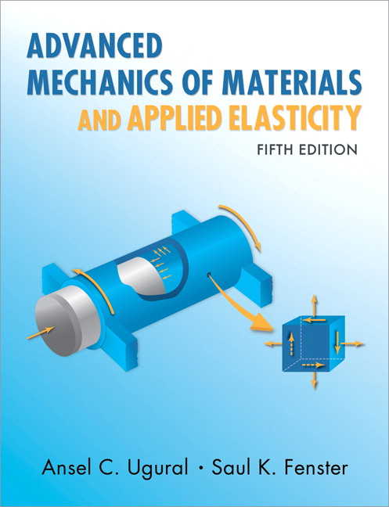
Advanced Mechanics
(Lecture 14)
ANNOUNCE / BUSINESS
HW 6 (due Thursday, 2/27)
HW 7 (due Sat, 3/01) – updated due date
Exam 02: Tuesday, 03/04 Q1: Failure criteria Q2: Contact stresses Q3: Stress concentration
PREVIOUS
Contact stresses
TODAY
Bending (Asymmetric cross-section)

Slide 2


Bending
Beam: object with one dimension much larger than the other two
Review of pure bending (moment constant along length; no shear stress)
Stress

Slide 3
Bending

Slide 4
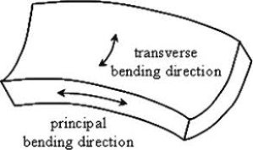




Bending - Strain
$$x$$
Strain
Anticlastic bending
$$y$$
$$ρ$$
$$θ$$

Slide 5
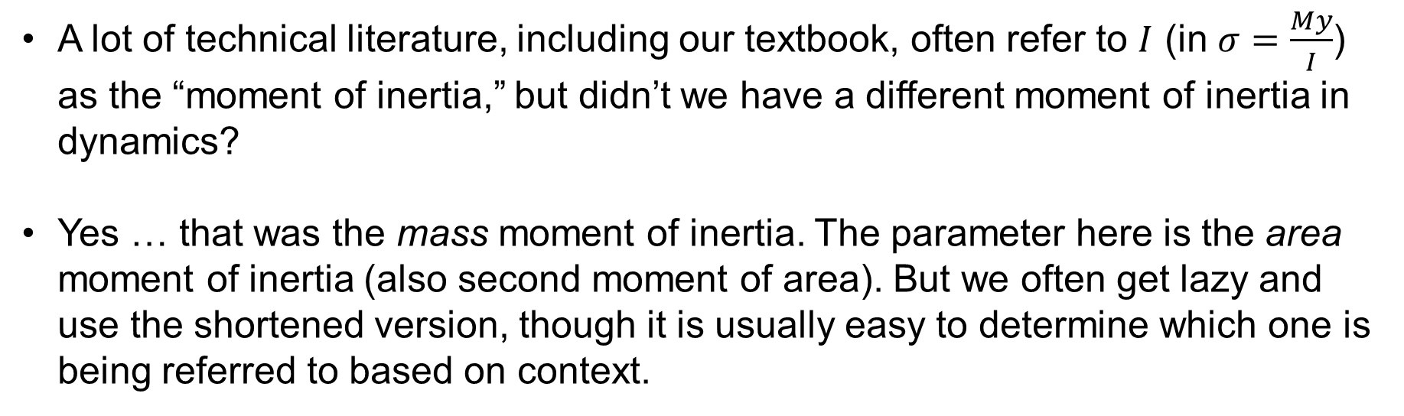
Moment of Inertia – A Word
A lot of technical literature, including our textbook, often refer to $I$ (in $σ=\frac{My}{I}$) as the “moment of inertia,” but didn’t we have a different moment of inertia in dynamics?
Yes … that was the mass moment of inertia. The parameter here is the area moment of inertia (also second moment of area). But we often get lazy and use the shortened version, though it is usually easy to determine which one is being referred to based on context.

Slide 6
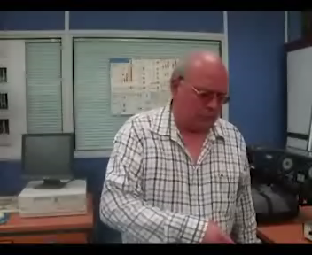
Asymmetric Bending
(Carl T. F. Ross, DSc; https://www.youtube.com/watch?v=owIvg9I37MM)

Slide 7
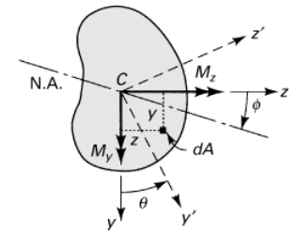
Asymmetric Bending
Asymmetric bending occurs when net applied moment is not about a principal axis
Derive expression for stress:

Slide 8


Asymmetric Bending
Equation of neutral axis
Note that the angle of the N.A. is dependent upon both the loading and the cross-sectional properties

Slide 9

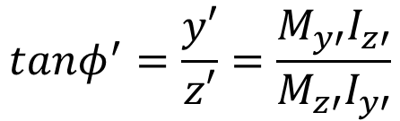
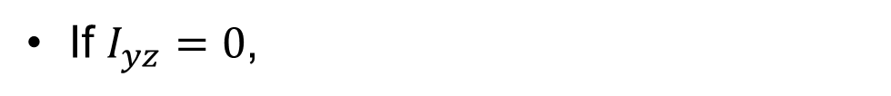
Asymmetric Bending
(true for symmetrical shapes when coords are aligned with axis of symmetry)
If $I_{yz}=0$,
(where the primed variables correspond with the principal axes of the section)
$$tanφ^{′}=\frac{y′}{z′}=\frac{M_{y′}I_{z′}}{M_{z′}I_{y′}}$$

Slide 10
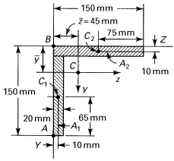
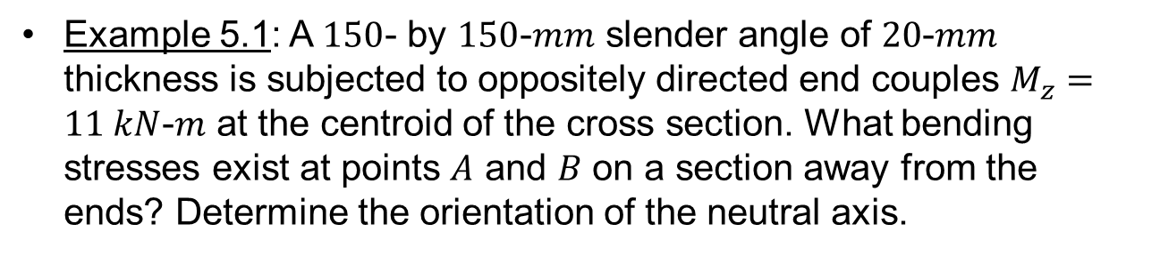
Example 5.1: A $150$- by $150$-$mm$ slender angle of $20$-$mm$ thickness is subjected to oppositely directed end couples $M_{z}=11 kN$-$m$ at the centroid of the cross section. What bending stresses exist at points $A$ and $B$ on a section away from the ends? Determine the orientation of the neutral axis.

